Slide 1
Adders and Multipliers

Slide 2
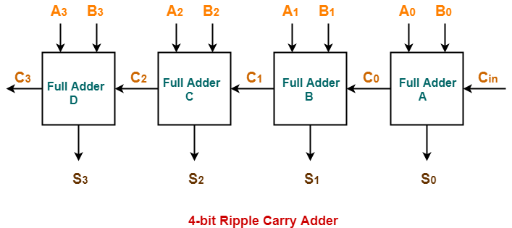
Ripple Carry Adder

Slide 3
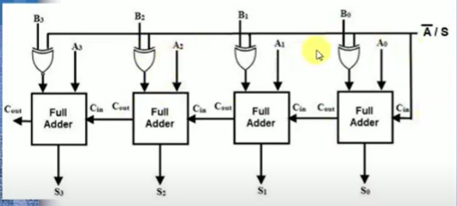
Adder cum Subtracter

Slide 4
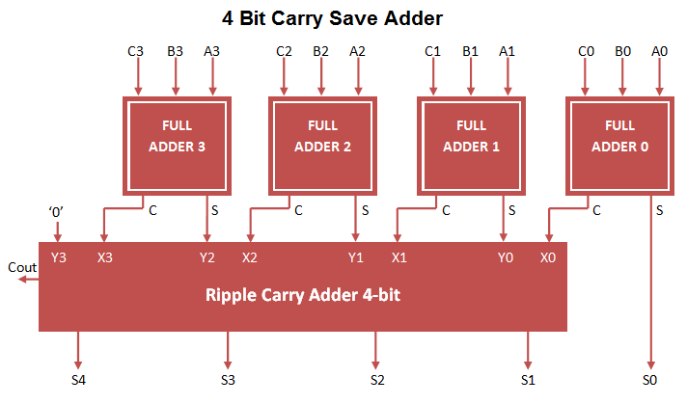
Carry Save Adder

Slide 5
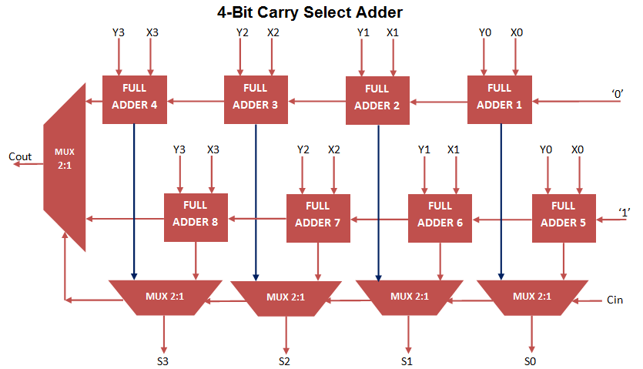
Carry select adder

Slide 6
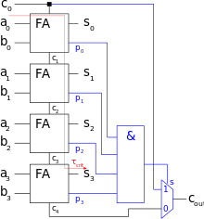
Carry skip adder

Slide 7
Carry Look Ahead Adder
Refer Digital book

Slide 8
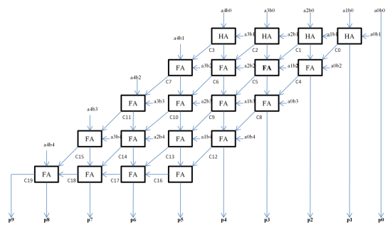
Array Multiplier

Slide 9
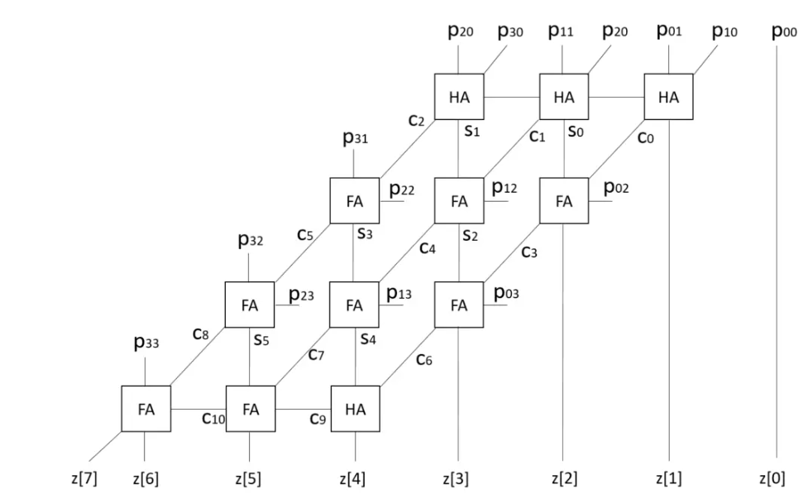
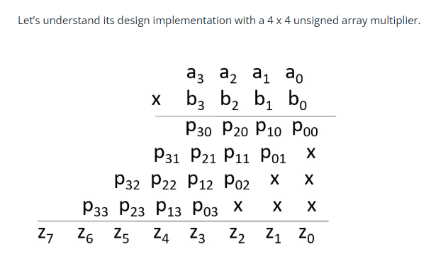

Slide 10
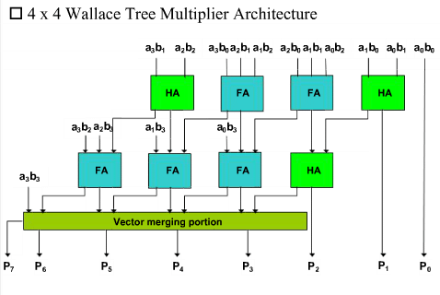
Wallace tree multiplier

Slide 11
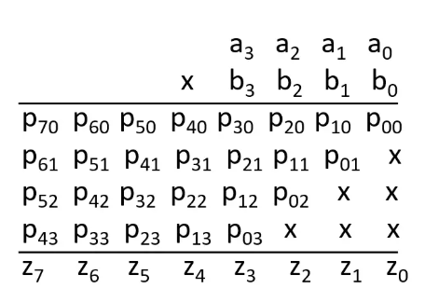

Slide 12
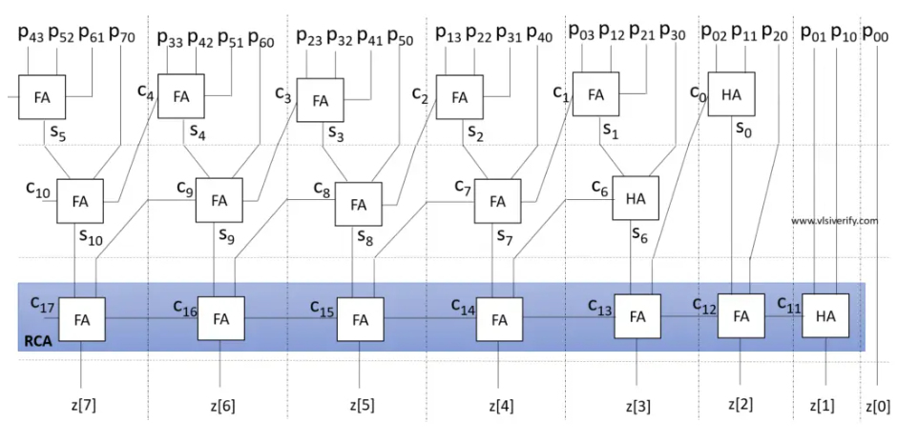

Slide 13
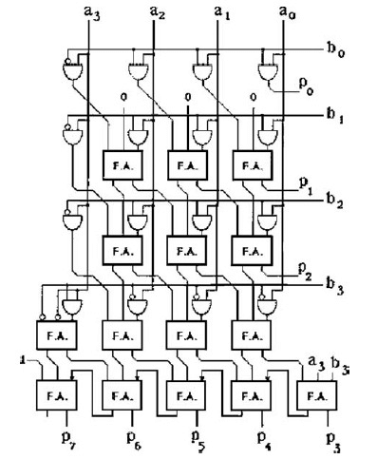
Baugh whooley multiplier

Slide 14
